Slide 1
Flutter
Prepared by Fares Ahmed

Slide 2
Agenda
01
02
03
04
Into to flutter environment
Stateful & Stateless
Essential Widgets
HandsOn

Slide 3
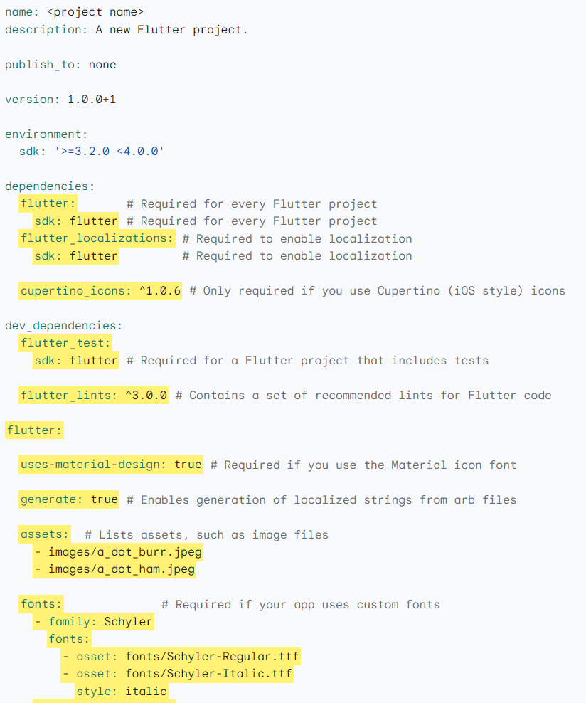
pubspec.yaml file
Notes:
First talk about YAML parts of pubspec.yaml YAML (data serialization format)
- It is not a programming language like C++.
- It is not Markup language like HTML.
- YAML is designed to be easily readable and writable by humans.
- It's used for representing configuration settings.
Unlike programming languages such as C++ or Python, YAML doesn't contain functions, conditionals, or loops.

Slide 4
Stateful Widget
A widget is either stateful or stateless. If a widget can change—when a user interacts with it, for example—it’s stateful
A stateful widget is dynamic: for example, it can change its appearance in response to events triggered by user interactions or when it receives data.
Checkbox, Radio, Slider, InkWell, Form, and TextField are examples of stateful widgets

Slide 5
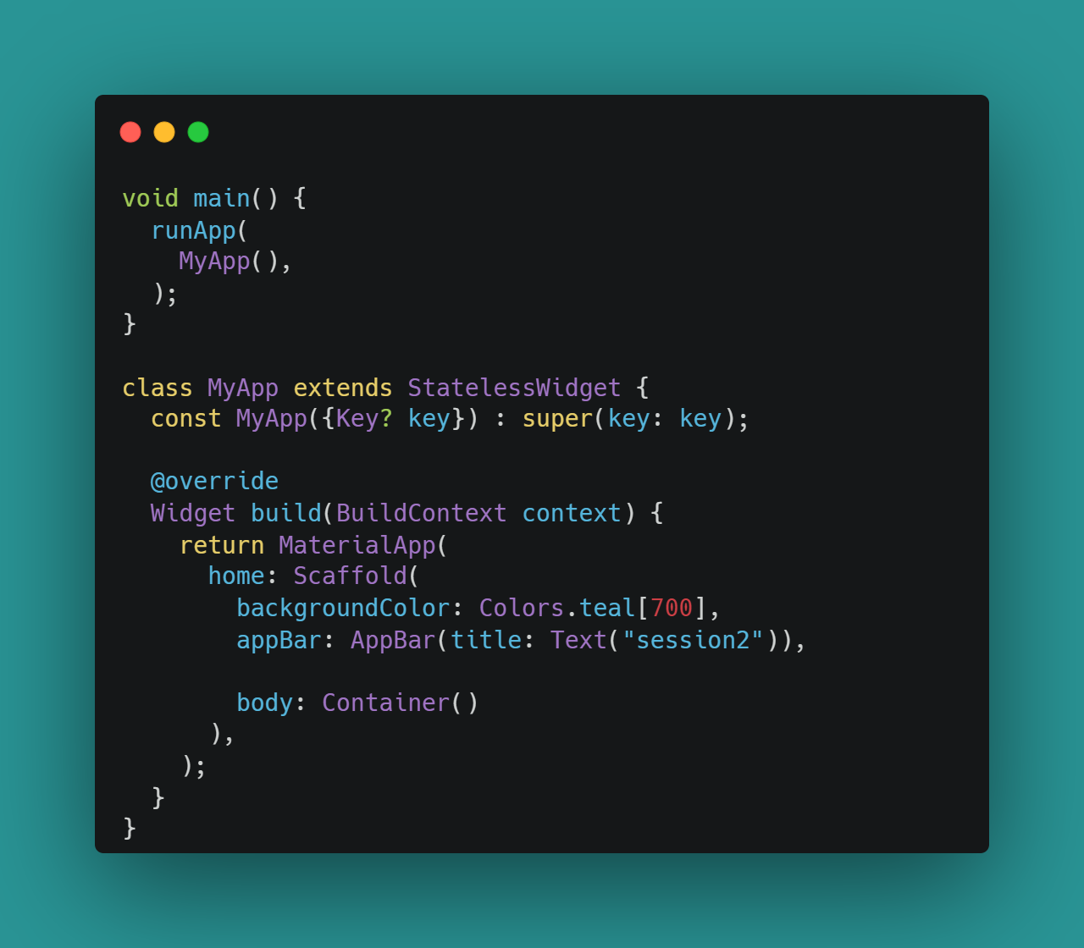
Stateless Widget
A stateless widget never changes
Icon, IconButton, and Text are examples of stateless widgets

Slide 6
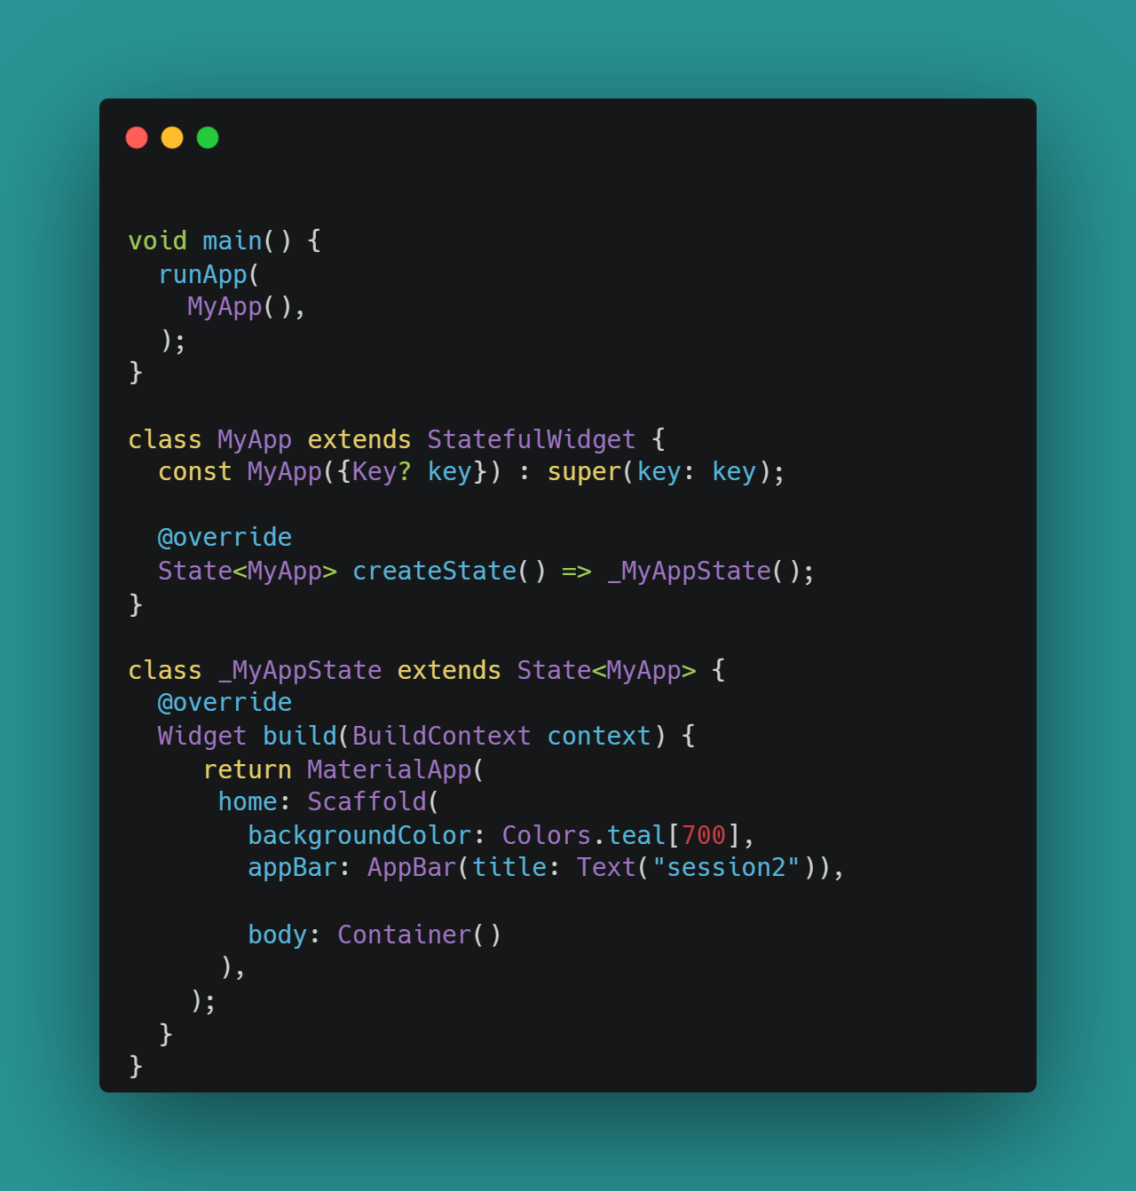
Stateful Widget
A generic method createState() creates a mutable state for the widget at a particular location and returns another class that is extended by the previous state
The _MyAppState class extends another state.
BuildContext: It provides information regarding which widget is to be built/re-build
SetState(): A State object is used to modify the user interface. It executes the code for a particular callback and repaints the widgets that rely on that state for configuration.

Slide 7
We can split the Flutter widgets into two categories:
Visible (Output and Input)
Invisible (Layout and Control)

Slide 8
Invisible Widget
related to the layout and control of widgets. It provides controlling how the widgets actually behave and how they will look onto the screen
MaterialApp
responsible for setting up the overall structure and configuration of a Flutter application
home, theme , navigation
Scaffold
provides a framework that allows you to add common material design elements
AppBar,Floating Action Buttons, Drawers
Column / Row
arranges all its children's widgets in a vertical / horizontal alignment
provides spacing between the widgets by mainAxisAlignment & crossAxisAlignment
Stack
mainly used for overlapping a widget
such as a button on a background gradient

Slide 9
Visible Widget
related to the user input and output data
Container
width: 200
child: Text(“string”)
Text
(“string”)
textAlign:TextAlign.center
style: TextStyle(height:100)
Button()
child: Text(“string”)
onPressed:(){do something}
Image
image: NetworkImage(“url”)
image: AssetImage()
alignment
ListView
itemBuilder(BuildContexrt,int)
physics:

Slide 10
ListView
GridView

Slide 11
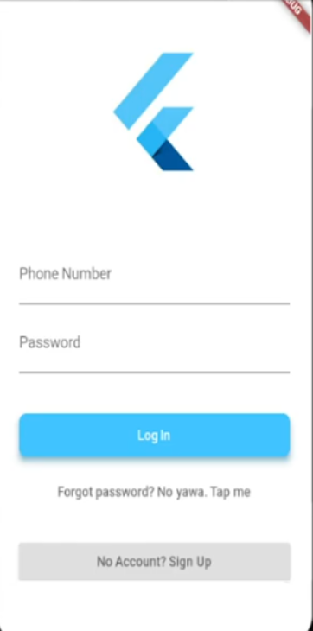
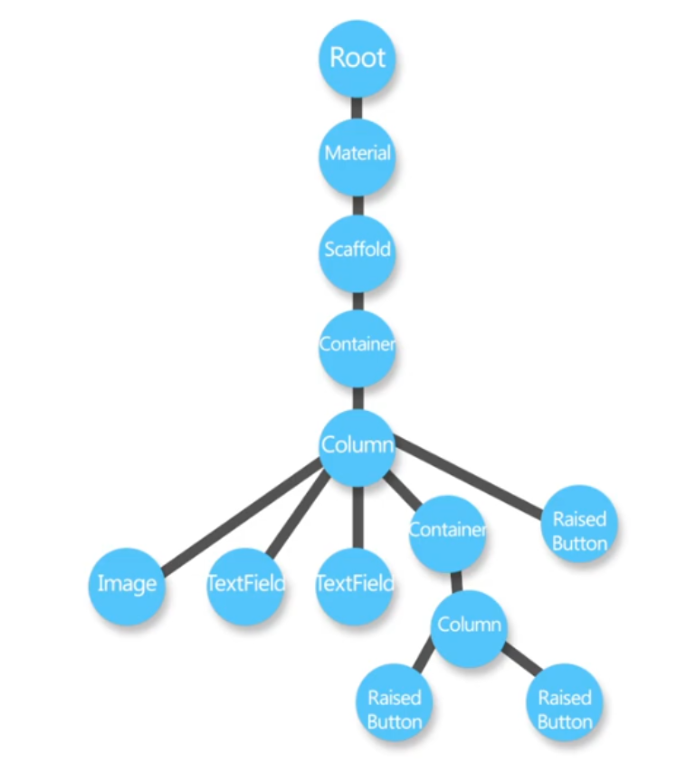
Widget Tree

Slide 12


